Slide 1

Fleet Revenue Enhancement
Improving our fleet while increasing revenue By Josue Guevara

Slide 2
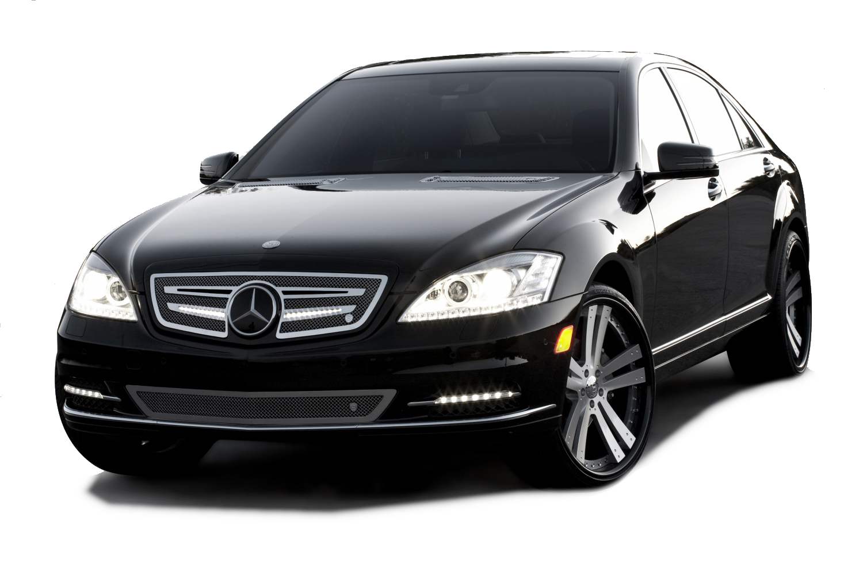
Deeper look into the data
Can we increase our revenue with our current fleet by 30%?
Can we get anything from the cost, branch revenue and amount of cars in our fleet?
This Photo by Unknown Author is licensed under CC BY-NC

Slide 3
Objectives and Goal
Analyze and adjust rental fleet to increase booking revenue
Bottom 50 booked cars
Best 10 booked cars
Combining both strategies
By controlling the fleet we can increase the overall revenue
Notes:
Get rid of the bottom 50 worst booked cars and increase revenue by 30% by increasing total bookings at a lower price.
Double the fleet for top 10 best booked cars. Organically grow bookings while increasing our price per booking
Combining both strategies and attaching a goal of 30% across the board.

Slide 4
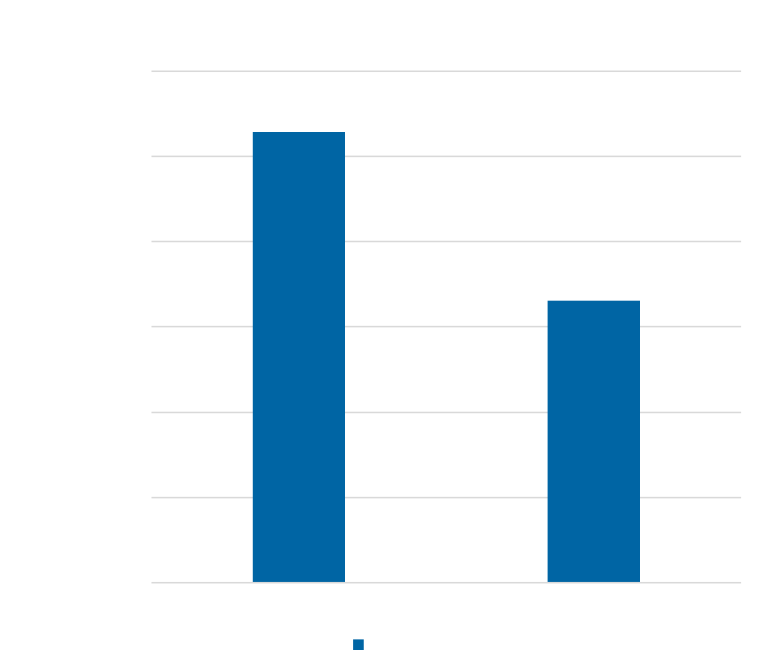
Where does the company stand in 2018?
Total Fleet | 4000
Avg Cost Per Booking | $91
Total Bookings | 81318
Avg Revenue Per Car | $11,363

Slide 5
Strategies
Strategy 1
Discontinue our bottom 50 worst selling car + Increase bookings and gross revenue by 30%
Strategy 2
Double our top 10 booked cars fleet assuming same results as 2018
Combined
Assuming we can combine both strategies to give the company a revenue boost.
Notes:
Strat 1: Get rid of our bottom 50 worst booked cars. Save on the cost of those cars, as they were only booked once the whole year. Reducing choices
Strat 2: Double our top 10 selling car assuming same results as current fleet while keeping same avg gross revenue per car. By having twice as many top performers in the same branches can allow higher bookings. As these are the cars people seem to gravitate towards..
Combining both strategies and boosting overall company performance

Slide 6
Strategy 1 Discontinue our bottom 50 worst selling car + Increase bookings target at a lower price point aiming to increase gross revenue by 30%
2018 Avg Booking Price | Strategy 1 Avg Booking Price
$91 | $69
Notes:
By removing worst booked cars we save on that cost, and by increasing our bookings we can charge a smaller hourly fee with the goal to bring more people into renting with us

Slide 7
Strategy 2 Double our top 10 booked cars fleet assuming same results as 2018
2018 Avg Booking Price | Strategy 2 Avg Booking Price
$91 | $102
Notes:
By increasing our top 10 booked cars and assuming same performance in bookings, we see a natural increase in bookings. The cost of the additional fleet can allow us to have a higher booking price and approach our business by using our top performers

Slide 8
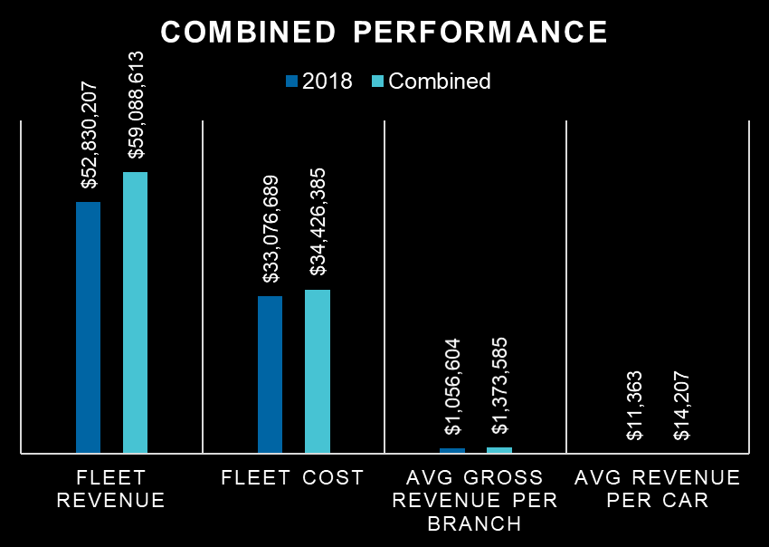
Combined Assuming we can combine both strategies to give the company a revenue boost. Using the cost of the bottom performers and re-invest it for new fleet
Consistent growth
Use demand of top 10 booked cars to drive revenue
Lower booking cost
 | 2018 | Combined
Total Fleet | 4,000 | 4,159
Avg per booking | $91 | $79
Total Bookings | 81,318 | 114,375
Notes:
By applying both strategies we can see a natural increase in bookings due to the demand of the top 10 booked cars. By cutting our bottom 50 cars we save on that cost and we can re-invest it back into the company. We see the average revenue per car go up as well as a boost of 30% per branch if we approach this as a whole fleet instead of looking at branch per branch

Slide 9
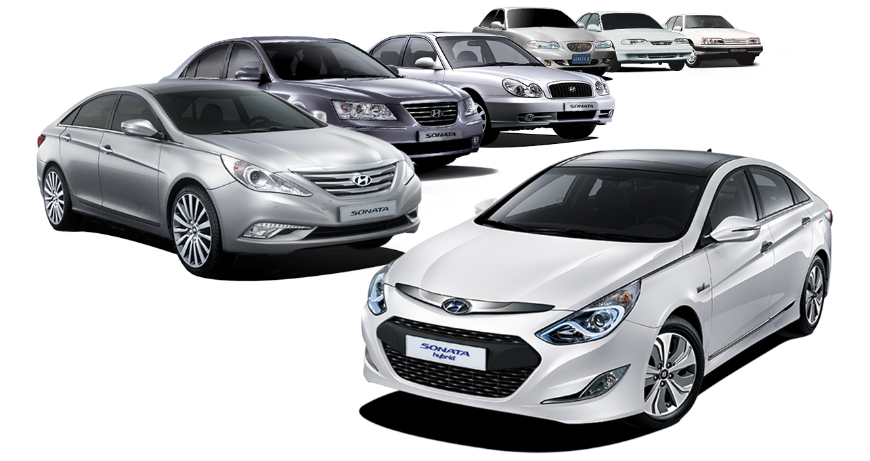
Next Steps By approaching our revenue at a macro level and focusing on adjusting the fleets
Increasing revenue by 30%
Requires to set a higher goal in bookings
Adjust our cost by discontinuing the bottom 50 cars
Increase our top 10 booked cars
Higher Metrics
30% revenue grow can be achieved in the first year with combined strategy
This Photo by Unknown Author is licensed under CC BY-NC

Slide 10
Q&A
Notes:
Open the room for questions

Slide 11
Thank you!
Notes:
Thank you!

